Slide 1
Computer Graphics MODULE 5 – Computer Animation

Slide 2
Points to be covered
Animation
Basic Animation Techniques
Principles of animation
Keyframing
Construction of Animation Sequence
Motion Control Methods
Procedural animation
Key-frame animation vs. procedural animation
Morphing
Warping
3D Morphing

Slide 3
Animation
Is a technique in which the illusion of movement is created by displaying on a screen or recording on a device ,individual states of dynamic scene.
Animation is about bringing things to life
Technically:
Generate a sequence of images that, when played one after the other, make things move
One image is called a frame
24 frames per second for film, resolution approx 1600x1200
30 frames per second for NTSC video, resolution less than 640x480
60+ frames per second for “twitch” computer games, 640x480 or higher resolution

Slide 4
History of Computer Animation:
YEAR | DEVELOPMENTS
1906 | “Humorous phase of funny faces” – 1st animated movie/film.
1909 | “Gertie the trained Dinosaur” – Cartoon was developed.
1913 | Felix the cat” and “Old doc Yak” – Cartoon series was developed.
1923 | Cartoon movie Alice’s Wonderland was created.
1926 | “Prince Achmed” – 1st full length animated movie.
1928 | “Mickey Mouse” – First cartoon with sound (developed by Walt Disney).
1970 | “Scanimate” – 1st analog video synthesizer.
1977 | “Star War” – First popular movie using animation.
1993 | “Jurassic Park”, movie using VFX and animation.
1995 | “Disney Pixar’s Toy Story” – 1st computer animation featuring film.
2003 | Movies like: “The Matrix Reloaded” and “The Matrix Revolutions”, used virtual cinematography.
2006 | Video Game named “Play Station 3” was developed.

Slide 5
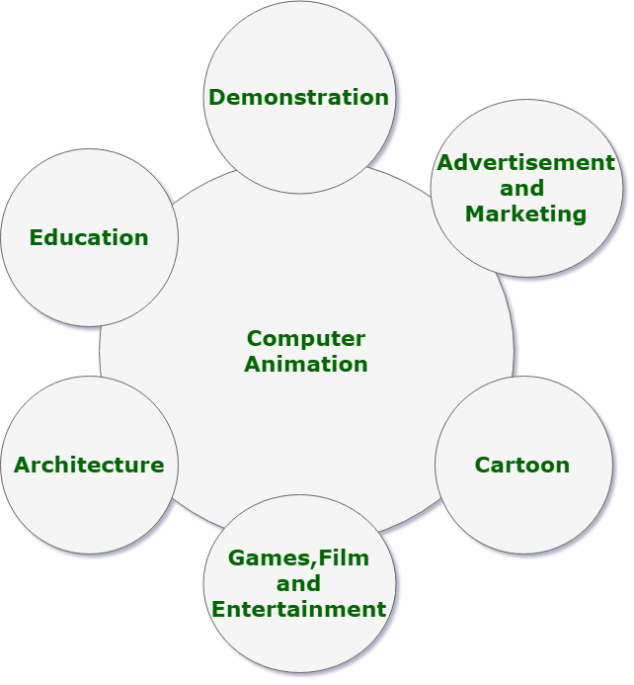
Applications of Computer Animation:

Slide 6
Methods/Techniques:
Frame by Frame (Traditional Method)
Procedural
Behavioral
Key Framing
Motion Capture
Dynamics

Slide 7
Basic Animation Techniques
Keyframe animation
Consists of automatic generation of intermediate frames based on the set of the key frames ,supplied by an animator.
Animator specifies important positions throughout the animation – the keyframes
Someone or something fills in the intermediate frames – inbetweening, or just ’tweening
Motion capture
System captures motion data from a real enactment of the animation
The data then drives a virtual character
Procedural animation
A set of equations or rules are evaluated to determine how the animation behaves

Slide 8
Types of animation
Cell Animation
2D Animation
3D Animation
Motion Graphics
Stop Animation

Slide 9
Principles of Animation
Early 2D Animation: Used traditional techniques
Early 3D Animation: Neglected traditional techniques.
Understanding the 11 Fundamental principles of traditional animation techniques is essential to producing good computer animation.

Slide 10
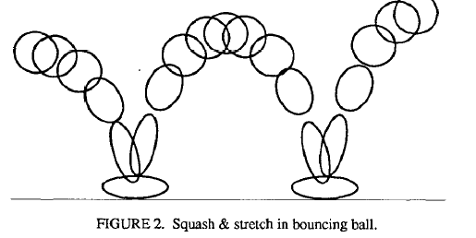
Principles of Animation
1. Squash and Stretch
Teaches basic mechanics of animation.
Defines rigidity of material.
Important in facial animation.

Slide 11
Principles of Animation
2. Timing and Motion
Gives meaning to movement.
Proper timing is critical to making ideas readable.
Examples:
1. Timing: tiny characters move quicker than larger ones.
2. Motion: can define weights of objects.

Slide 12
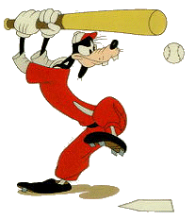
Principles of Animation
3. Anticipation
Preparation for an action
Example:
Goofy prepares to hit a baseball.

Slide 13
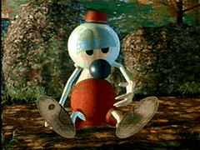
Principles of Animation
4. Staging
A clear presentation of an idea.
Some Techniques:
Use motion in a still scene or use of static movement in a busy scene.
Use of silhouettes (to the side)

Slide 14
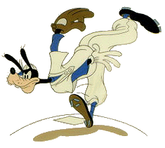
Principles of Animation
5. Follow Through and Overlapping Action
1. Follow Through
Termination part of an action.
Example: after throwing a ball
2. Overlapping Action
Starting a second action before the first has completed.
Example: Luxo Jr.’s hop with overlapping action on chord.

Slide 15
Principles of Animation
6. Straight Ahead Action and Pose-to-Pose Action
1. Straight Ahead
Animator start from first drawing in the scene and draw all subsequent frames until the end of scene.
2. Pose-to-Pose
Animator plans actions, draws a sequence of poses, in between frames etc.

Slide 16
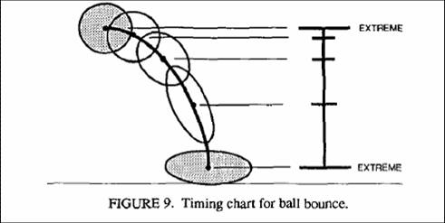
Principles of Animation
7. Slow in and Out
Spacing of inbetween frames to achieve subtlety of timing and movement.
3d keyframe comp. Systems uses spline interpolation to control the path of an object.
Has tendency to overshoot at extremes (small # of frames).

Slide 17
Principles of Animation
8. Arcs
Visual path of action for natural movement.
Makes animation much smoother and less stiff than a straight line.

Slide 18
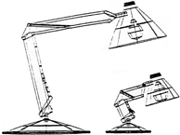
Principles of Animation
9. Exaggeration
Making noticeable through an idea, design and the action.
Needs to be used carefully.
Example: Luxo Jr. made smaller to give idea of a child.

Slide 19
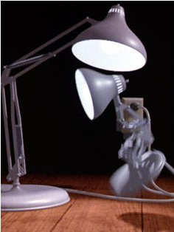
Principles of Animation
10. Secondary Action
Action that results directly from another action.
Used to increase the complexity and interest of a scene.
Example:
Body movement is the primary action, facial expression is the secondary action

Slide 20
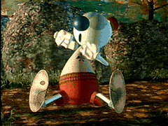
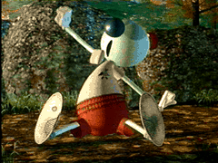
Principles of Animation
11. Appeal
Refers to what an audience would like to see.
Character cannot be too simple (boring) or too complex.
Examples:
Avoid mirror symmetry, assymmetry is interesting.

Slide 21
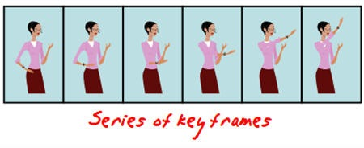
Keyframing
The original way to animate, and still the most common form for feature animation
Process has shifted to computers, but basic approach is the same
Underlying technique is interpolation
The in-between frames are interpolated from the keyframes
Originally done by armies of underpaid animators
Now done with computers

Slide 22
Construction of animation sequence
Storyline
Object definition
Key frame specification
Tweening

Slide 23
Motion Control Methods
It specifies how an actor is animated and may be characterized according to the type of information to which it is privileged in animating the synthetic actor
MCM methods based on Following information
Geometric and kinematics
Typically the animator provides a lot of geometric data corresponding to a local definition of the motion. Inverse kinematic methods may be also considered as being in this category.
Physical
guarantees a realistic motion by using kinematics and dynamics
Behavioral
takes into account the relationship between each object and the other objects.

Slide 24
Motion Control Methods
Methods based on Geometric and Kinematics information
heavily relied upon the animator. Motion is locally controlled and defined in terms of coordinates, angles, velocities, or accelerations.
Methods based on Physical information
the animator provides physical data and the motion is obtained by solving the dynamic equations.
distinguish methods based on parameter adjustment and constraint-based methods, where the animator states in terms of constraints the properties the model is supposed to have, without needing to adjust parameters.
Methods based on Behavioral information
A behavioral motion control method consists of driving the behavior of autonomous creatures by providing high-level directives indicating a specific behavior without any other stimulus.

Slide 25
Procedural Animation
In a procedural animation objects are animated by a procedure -- a set of rules -- not by keyframing.
The animator specifies rules and initial conditions and runs simulation.
Rules are often based on physical rules of the real world expressed by mathematical equations.

Slide 26
Procedural Animation
Categories of procedural animation
Two large categories of procedural animation are
1. Physics-based modeling/animation
Particle systems
Flexible dynamics
Rigid body dynamics
Fluid dynamics
Fur/hair dynamics
2. Alife (artificial life)
Behavioral animation
Artificial evolution
Branching object generation

Slide 27
Procedural Animation
1. Physics-based modeling/animation
It deals with things that are not alive.
Physics-based modeling/animation refers to techniques that include various physical parameters, as well as geometrical information, into models.
The behavior of the models is simulated using well-know natural physical laws.
Physics-based modeling/animation can be considered as a sub-set of procedural animation

Slide 28
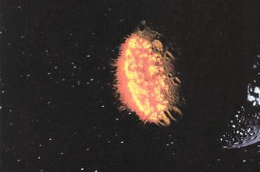
Procedural Animation
A. Particle systems
It imulates behaviors of fuzzy objects, such as clouds, smokes, fire, and water.
"Star Trek II" Genesis Effect"

Slide 29
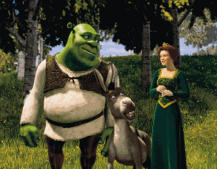
Procedural Animation
B. Flexible dynamics
It simulates behaviors of flexible objects, such as clothes.
A model is built from triangles, with point masses at the triangles’ vertices.
Triangles are joined at edges with hinges; the hinges open and close in resistance to springs holding the two hinge halves together.
Parameters are: point masses, positions, velocities, accelerations, spring constants, wind force, etc
"Shrek 2"

Slide 30
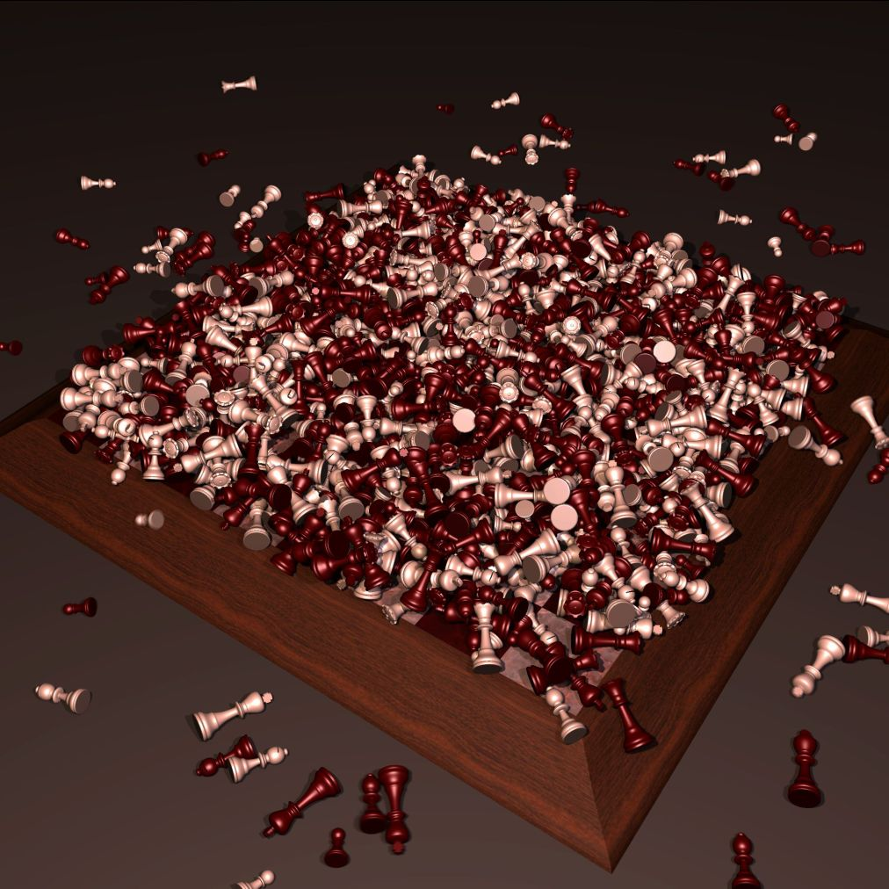
Procedural Animation
C. Rigid body dynamics
It simulates dynamic interaction among rigid objects, such as rocks and metals, taking account various physical characteristics, such as elasticity, friction, and mass, to produce rolling, sliding, and collisions.
Parameters for “classical” rigid body dynamics are masses, positions, orientations, forces, torques, linear and angular velocities, linear and angular moment, rotational inertia tensors, etc.
Fast frictional dynamics for rigid bodies

Slide 31
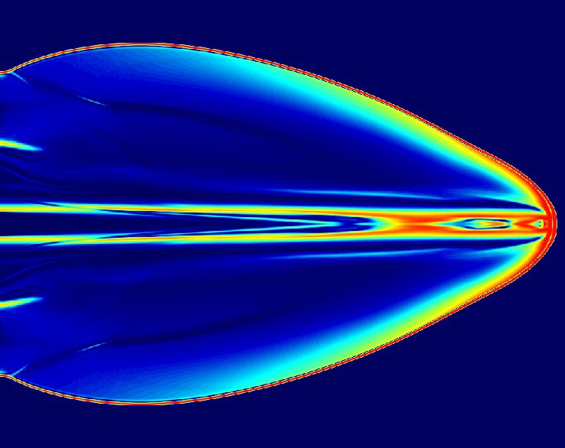
Procedural Animation
D. Fluid dynamics
It simulates flows, waves, and turbulence of water and other liquids.
Computational fluid dynamics

Slide 32
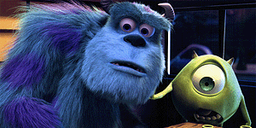
Procedural Animation
E. Fur & hair dynamics
It generates realistic fur and hair and simulates behaviors of fur and hair. Often it is tied into a rendering method.
"Monsters, Inc."

Slide 33
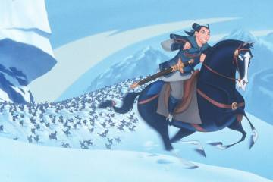
Procedural Animation
2. Alife (artificial life) deals with things are virtually alive.
A. Behavioral animation
It simulates interactions of artificial lives. Examples: flocking, predator-prey, virtual human behaviors
"Mulan"

Slide 34
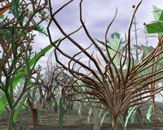
Procedural Animation
B. Artificial evolution
It is the evolution of artificial life forms.
The animator plays the role of God.
As artificial life forms reproduce and mutate over time, the survival of the fittest is prescribed by the animator's definition of "fittest" (that is artificial 'natural' selection).
"Panspermia" by Karl Sims

Slide 35
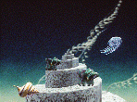
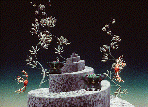
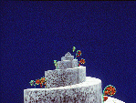
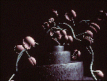
Procedural Animation
C. Branching object generation
It generates plants, trees, and other objects with branching structures and simulate their behaviors.
Without a procedural method, building a model of a branching object, such as a tree with a number of branches, requires a lot of time and effort.
Branching object generation methods (L-systems & BOGAS) employ user defined rules to generate such objects.
Procedural Animation

Slide 36
Key-frame animation vs. procedural animation
To produce a keyframe animation, the animator creates the behavior of a model manually by using an intuitive “put that there” methodology.
The animator has direct control over the positions, shapes, and motions of models at any moment in the animation.
On the other hand, to produce a procedural animation the animator provides initial conditions and adjust rather abstract physical parameters, such as forces and torques, in order to control positions, shapes, and motions of models.
The effect of changing a parameter value is often unpredictable in procedural animation. The animator has to run a simulation to see the result.

Slide 37
Morphing
Morphing – derived from the word metamorphosis.
Metamorphosis means to change shape, appearance or form
Example:

Slide 38
Morphing
What is morphing?
Morphing can be defined as: - Transition from one object to another. - Process of transforming one image into another.
An animation technique that allows you to blend two
still images, creating a sequence of in – between
pictures that when played in Quick Time
metamorphoses the first image into the second.

Slide 39
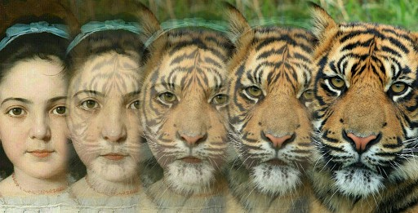
Morphing
How is morphing done?
As the metamorphosis proceeds ,
The first image is gradually distorted and is faded out.
The second image starts out totally distorted toward the first and is faded in.

Slide 40
Morphing
Steps in morphing
The morph process consists of :-
1. Warping two images so that they have the same “shape’’.
2. Cross dissolving the resulting images .

Slide 41
Warping
A warp is a 2-D geometric transformation and generates a distorted image when it is applied to an image.
Warping an image means : apply a given deformation to it.
Two ways to warp an image:- → Forward mapping. → Reverse mapping.

Slide 42
Warping
Forward Warping
Each pixel in source image is mapped to an appropriate pixel in destination image.
Some pixels in the destination image may not be mapped.
Reverse Warping
This method goes through each pixel in the destination image and samples an appropriate source image pixel.
All destination image pixels are mapped to some source image pixel.
This mapping is used in the Beier/Neely line morphing method.

Slide 43


Cross Dissolving
A cross-dissolve is a sequence of images which implements a gradual fade from one to the other.

Slide 44
Morphing
THE MORPHING PROCESS
Step I : Interpolating the lines: → Interpolate the coordinates of the end points of every pair of lines.
Step II : Warping the Images → Each of the source images has to be deformed towards the needed frame. → The deformation works pixel by pixel is based on the reverse mapping. This algorithm is called Beier-Neely Algorithm.

Slide 45
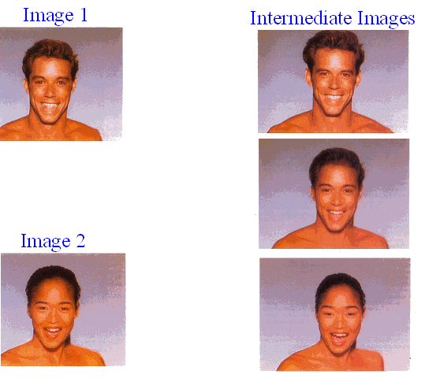
Morphing
Examples

Slide 46
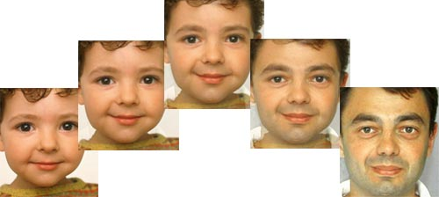
Morphing
Examples
2D Morphing

Slide 47
3D Morphing
What is 3D morphing ?
A 3D model of the object is transformed from one shape into another.
Why 3D morphing ?
Morphs are independent of viewing and lighting parameters.
View-dependent effects possible e.g., shadows, highlights, camera can be animated during the morph.
Traditional 2D morphs are inherently “flat” looking.
Features of a Good 3D morphing algorithm
Conceptually Simple
Minimal topological restrictions.
Easy to use user-control

Slide 48
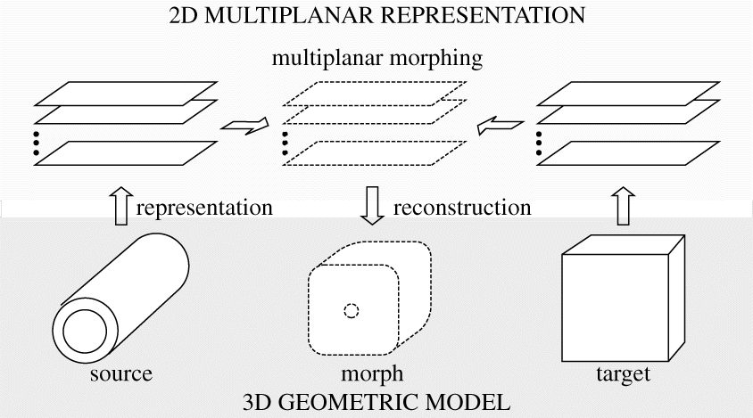
3D Morphing

Slide 49
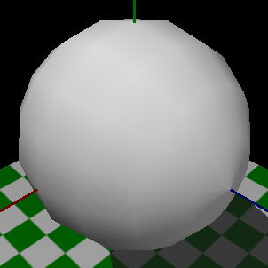
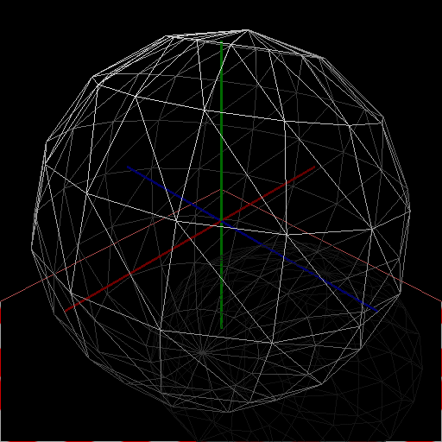
3D Morphing
Polygons
(triangles)
Other parameters
(normal, textures)
Model
vertices

Slide 50
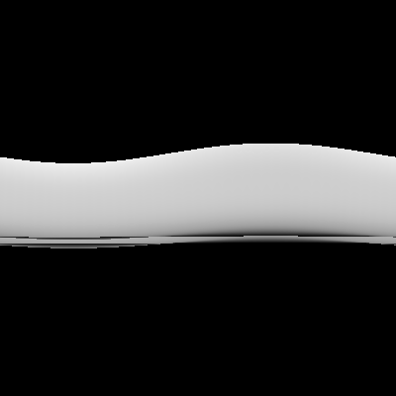
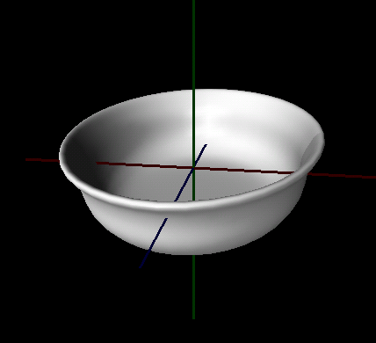
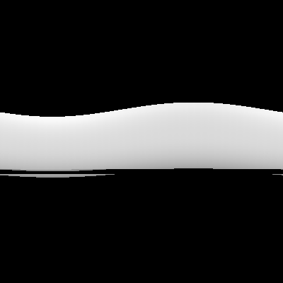
3D Morphing
Convert model vertices from (x,y,z)
to (ht, theta, radius) space.
Scan convert each triangle.
r1,r2
ht
theta
3D model
(Axis = green)
ht
r1
r2
“Radius” Images
(brighter = farther
darker = closer to axis
black = no point on object)
theta
Axis

Slide 51
3D Morphing
All the advantages of 3D over 2D morphing are inherited.
Complexity of 3D morphing is not there
Works for different topologies, as opposed to some existing methods.
All other parameters (textures, normal, colors,...) can be morphed similarly.
3D
NA

